Slide 1

SAP BTP ABAP on Cloud / RAP Training
DAY-9
Anubhav Oberoy
www.AnubhavTrainings.com
Follow excellence with sheer passion

Slide 2


DISCLAIMER
The training content and delivery of this presentation is confidential, and cannot be recorded, or copied and distributed to any third party, without the written consent of Anubhav Trainings

Slide 3

01
Behaviour Pool
02
Early Numbering
03
Feature Control
04
Actions
Notes:
https://pixabay.com/photos/san-francisco-transamerica-pyramid-1633203/

Slide 4

Development Flow – Processor and Approver
Fiori App – Processor
Create, update, delete, copy travel
Fiori App – Approver
Display the travel request data
Service definition
Service Binding
Service definition
Service Binding
MDE for Processor Projection
MDE for approver Projection
BDEF Projection
For Processor
Expose what is needed by a processor role in company
Behavior Definition (BDEF)
Tell RAP framework regarding our operations which needs to be supported for BO (managed)
BDEF Projection
For Approver
Expose what is needed by a approver role in company
Business Object Projection
For Processor
30 fields to internet
Business Object (definition)
Includes the Travel, Booking and Booking Supplement CDS entities
100 fields
Business Object Projection
For Approver
25 fields
www.anubhavtrainings.com

Slide 5

Behavior Pool
The transaction behavior of a BO in the context of RAP is implemented in one or more than one global class.
These special classes are dedicated only to implementing the business object behavior and called as behavior pool.
You can assign any number of behavior pool to behavior definition (a 1:n relationship)
Within a single global class, we can define multiple local classes that can handle the business object behavior.
The global class is just like a container and basically empty while the actual behavior logic is written inside the class pool.
We can assign any number of behavior pool to behavior definition (1:n). This allows us to distribute our implementation across multiple units. This is called contribution design pattern. Which allow team to work in parallel on multiple tasks.
A behavior implementation class always inherits from cl_abap_behavior_handler class.
Travel
(root)
Behavior pool
Helper classes
Booking
Behavior pool
Booking Suppl
Behavior pool
www.anubhavtrainings.com

Slide 6
Implicit Response Parameters
When implementing a BO contract, we can make use of implicit parameters. These parameters do not have FIX data type, instead they are assigned by the compiler with the type derived from BDEF.
The implicit parameters can be declared explicitly as CHANGING parameters in the method signature of the class using generic type
DATA: lt_imp_param FOR <OPERATION> entity.
Data : lt_mapped FOR CREATE BO-Travel.
FAILED
This is an exporting parameter which is defined as nested table contains one table for each entity. The failed table includes the information for identifying the data set where the error occurred. It has %CID, the ID of the BO instance, %FAIL which has the reason of failure. If_abap_behv=>t_failinfo
REPORTED –
This is an exporting parameter which is defined as nested table contains one table for each entity.it includes the instance specific messages.
%CID, ID of the relevant BO, %MSG with the message interface, %ELEMENT
MAPPED – Only during Create/Update operation
This is an exporting parameter which is defined as nested table contains one table for each entity. The mapped parameter provide the consumer with ID mapping information. They include information about key values were created by the application for given content id. The BO runtime passes the created key values in any subsequent call in the sample request.
%CID and %KEY
www.anubhavtrainings.com

Slide 7
BO instance features
Early numbering
It allows a managed numbering for bo instances during creation process. Like in ABAP we use sequence numbers (SNRO) to auto generate primary keys, here in RAP we can use early numbering. It can be handled for all the entities. For this we need to implement the logic in RAP BIMP.
Every assigned key must be unique, otherwise the instances will be rejected by the database which will result to dump. We will be reusing a SNRO sequence already created by SAP in the system.
www.anubhavtrainings.com

Slide 8
Sequence of calls
Fiori app
OData
RAP
BIMP
HANADB
entities
FAILED, MAPPED, REPORTED
www.anubhavtrainings.com

Slide 9
Exercise
Assign the booking Supplement ID automatically during creation with early numbering.
www.anubhavtrainings.com

Slide 10
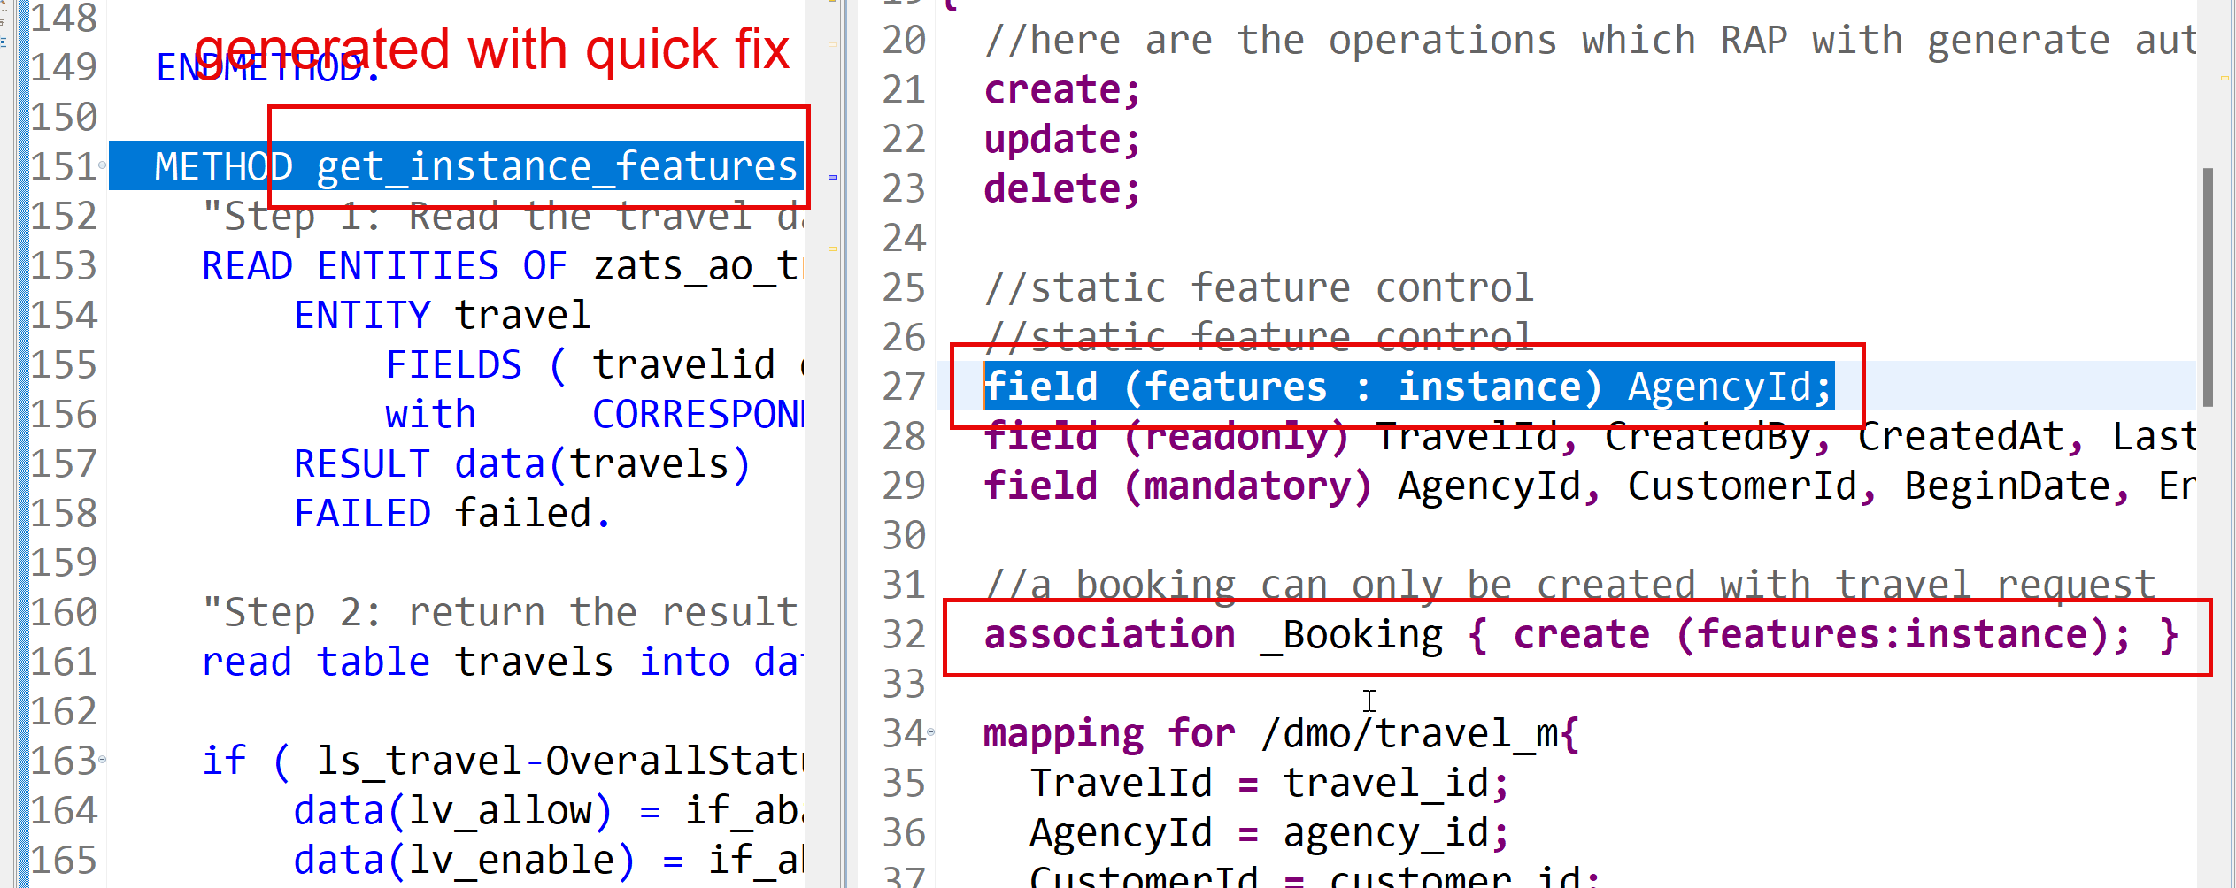
Feature Control
As an application developer we want to determine which entities of our BO needs to allow create-, update-, delete- operations. Apart from that which properties of BO are allowed to be mandatory, read only, creatable, updatable. We can also control the availability of our data actions.
In RAP, feature controls are of 2 types:
Static feature control – are specified at the level of behavior definition only. Statically declared and easy to implement.
Dynamic feature control – complex to implement for more complex requirements. They require a mandatory implementation in BIMP class. We use keyword features:instance
www.anubhavtrainings.com

Slide 11
Data Actions in RAP
In the context of RAP, an action is a non-standard operation that change the data of a BO instance or create new BO instances. They are self implemented operations. There are two main categories of data actions can be implemented in RAP:
Non factory action: Defines a RAP action which offers the non-standard behavior and implement custom logic in handler with MODIFY clause. A non factory action can be of 2 sub types (change a property of a record)
Static – they are not bound to any instance, they are generic and can be applied to all instances, like we want to change the booking fees for all travel request as fix price during promotion period.
Instance – An action that, by default relates to a BO RAP entity instance and changes the state of BO instance. E.g. like approve or reject a travel request where user choose a instance which they want to work with.
Factory Action – A factory action used to create new BO instances. A factory action can be instance-bound (default) or static.
Instance – that copy specific values of an instance and create new instances based on copied data
Static – can be used to create instances with prefilled default values
www.anubhavtrainings.com

Slide 12
Determination
A determination modifies instance of business object based on trigger condition. Trigger condition can be modify operations such as create, update, and delete and modified field. There are 2 types of determination
on modify – will be triggered before save whenever trigger condition is met e.g. when I change booking fee
on save – will always trigger at the time of save
Steps
Add the code for defining the determination in behavior definition, we want to do it in reusable way
Use quick fix to generate the code for determination
Define a structure where we can store all the booking fees and currency code
Read all travel instances, subsequent bookings using EML
Total all booking and supplement amounts which are in common currency
Delete the values w/o any currency
Loop at all amounts and compare with target currency
Perform currency conversion
Put back the total amount
Return the total amount in mapped so the RAP will modify this data to DB
www.anubhavtrainings.com

Slide 13
Validations
Many times we would like to perform business specific checks in our application, The rap framework is only responsible to perform CURDQ operations. It does not know what are all the business rules applies to our code.
If we return FAILED and MESSAGE then the RAP will terminate the update/create and shows the message to the user on Fiori App.
www.anubhavtrainings.com

Slide 14
Determination
A determination modifies instance of business object based on trigger condition. Trigger condition can be modify operations such as create, update, and delete and modified field. There are 2 types of determination
on modify – will be triggered before save whenever trigger condition is met e.g. when I change booking fee
on save – will always trigger at the time of save
Steps
Add the code for defining the determination in behavior definition, we want to do it in reusable way
Use quick fix to generate the code for determination
Define a structure where we can store all the booking fees and currency code
Read all travel instances, subsequent bookings using EML
Total all booking and supplement amounts which are in common currency
Delete the values w/o any currency
Loop at all amounts and compare with target currency
Perform currency conversion
Put back the total amount
Return the total amount in mapped so the RAP will modify this data to DB
www.anubhavtrainings.com

Slide 15
Validations
Many times we would like to perform business specific checks in our application, The rap framework is only responsible to perform CURDQ operations. It does not know what are all the business rules applies to our code.
If we return FAILED and MESSAGE then the RAP will terminate the update/create and shows the message to the user on Fiori App.
www.anubhavtrainings.com

Slide 16
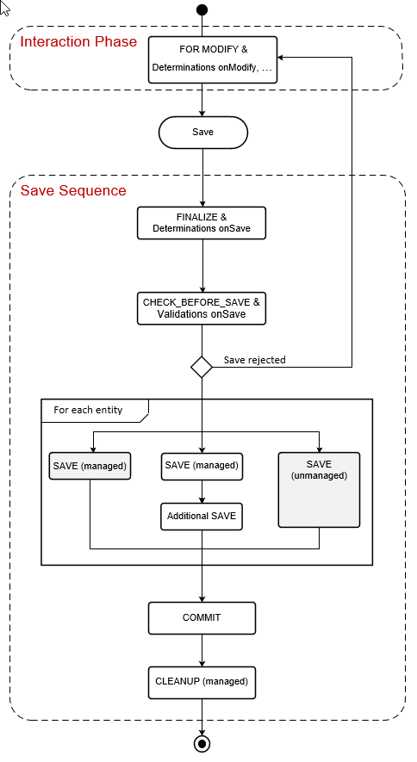
www.anubhavtrainings.com

Slide 17
Side Effects
Side effects are useful in UI scenarios based on BO which makes the Fiori element UI know/aware about the data changes in backend. Whenever data is reevaluated in backend, the frontend is unaware of that, we need to make sure that the frontend make a forceful call to GET the data back on UI.
The Fiori UI will never make an unnecessary call to perform a round trip. If we know that, a change in a field would certainly change the data in SAP system, we need to inform the same to RAP BO, so that it can make a GET call to reload the particular field value and display the updated data on UI. E.g. when we change the booking fee, or flight price under booking table, we need to reload the total price (which is getting calculated in backend using determination), this is exactly what the side effect can do for us.
www.anubhavtrainings.com

Slide 18
Draft
Draft is a very important functionality of an enterprise application, which allows us
To create a stateful application from stateless
Store intermediate data in sap system
Perform validations on-fly, increases the collaboration with our app
Device switch
The Odata V4 never allow CURD operation without having draft feature to your BO
www.anubhavtrainings.com

Slide 19
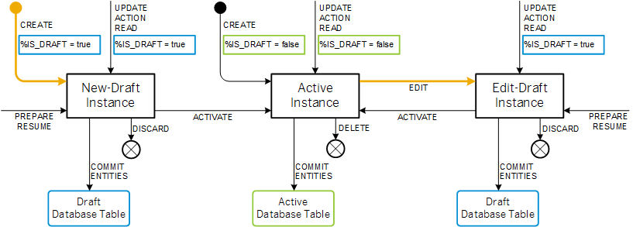
Draft Runtime
www.anubhavtrainings.com

Slide 20
www.anubhavtrainings.com
Thank You
End of Day 7
www.anubhavtrainings.com

Slide 21


We’re committed to empower you to be
#FutureReady
through powerful training solutions.
We build the workforce of the future.
250+
Corporate Clients
30,000+
Learners Trained
25000+
Learners Placed
FREE WEBINARS
Sign up for free webinars with industry experts every fortnight!
Enroll Now!
Contact us today!
https://anubhavtrainings.com

